Slide 1
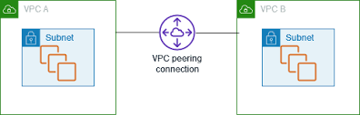
VPC Peering

Slide 2
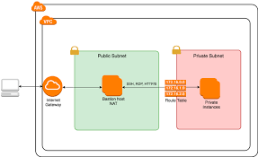
Introduction to VPC
A Virtual Private Cloud (VPC) is a logically isolated section of a public cloud provider's infrastructure that allows you to create and manage your own virtual network.

Slide 3
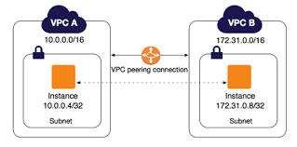
What is VPC Peering?
VPC Peering is a networking service that allows two Virtual Private Clouds (VPCs) to communicate with each other using private IP addresses, as if they were part of the same network.

Slide 4
Use Cases of VPC Peering
Connect development and production environments.
Centralized logging and monitoring.
Cross-account service sharing.
Cost-effective alternative to public internet.

Slide 5
Types of VPC Peering
Intra-region Peering
Inter-region Peering
Cross-account Peering

Slide 6
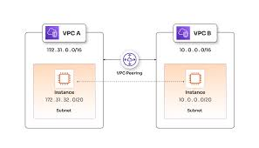
How VPC Peering Works
VPC peering establishes a private network connection between two VPCs, enabling communication between their resources using private IP addresses.

Slide 7
VPC Peering Configuration
Start
Identify Source and Target VPCs
Same account or different AWS accounts?
Check CIDR Block Overlap
✅ No Overlap → Proceed
❌ Overlap → Stop (Change CIDRs)
Initiate VPC Peering Request
From Source VPC → To Target VPC
Accept Peering Request
In Target VPC’s account
Update Route Tables
Add routes in both VPCs to route traffic via Peering connection
Update Security Groups (Optional but recommended)
Allow traffic from the peered VPC’s CIDR
Test Connectivity
Ping or access services across VPCs
VPC Peering Complete

Slide 8
THANK YOU

